Slide 1

project ON “PHONEBoOK APPLICATION” IN C LANGUAGE
NAME : B.M.Sudhamsh
ROLL NO : 22bd1a1210
DATE : 17-feb-2023
TITLE : phonebook application in c lang

Slide 2
introduction
Aim of the project
Problem statement
Modules
Algorithm
Screenshots

Slide 3
Problem statement
Program in c to add new records (contacts including name, country code ,mobile number ,gender ,mail id) ,listing ,modify ,update ,search for saved contacts ,deleting phone book records and stores the records.

Slide 4
AIM OF THE PROJECT
To develop an “PHONEBOOK CONTACT” application using c programming.
This program is very useful now-a-days to store complete information under single contact number.

Slide 5
DESIGN
PROGRAM CONISTS OF FOLLOWING MODULES
Preprocessor commands
Structures
Switch cases
Files
Functions
Variables
Statements & expressions

Slide 6
Header files
#include<stdio.h>
#include<conio.h>
#include<string.h>
#include<stblib.h>

Slide 7
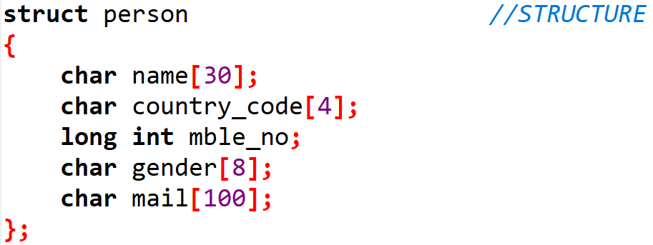
structures

Slide 8
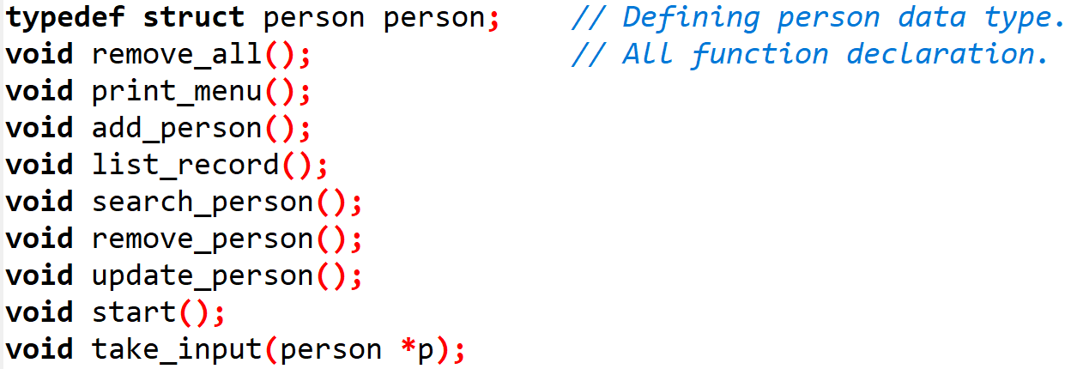
function declaration

Slide 9
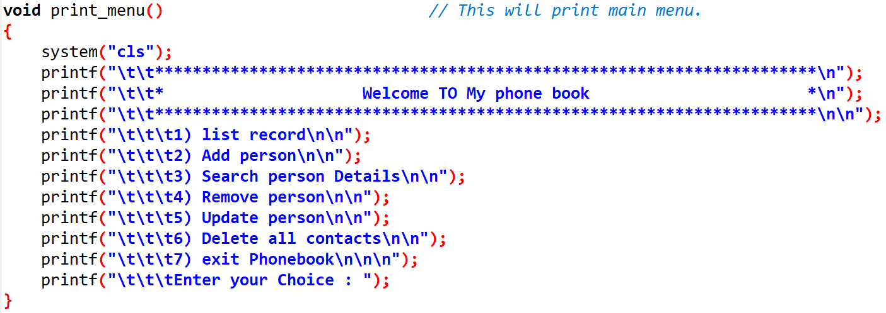
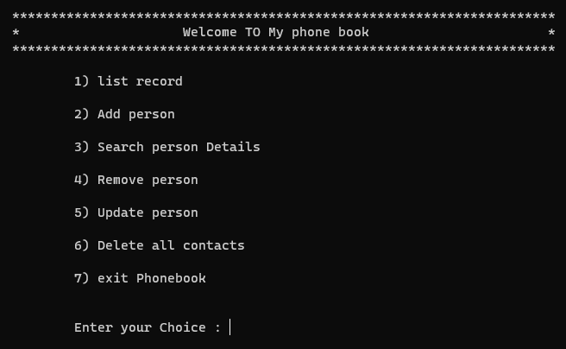
Main menu

Slide 10
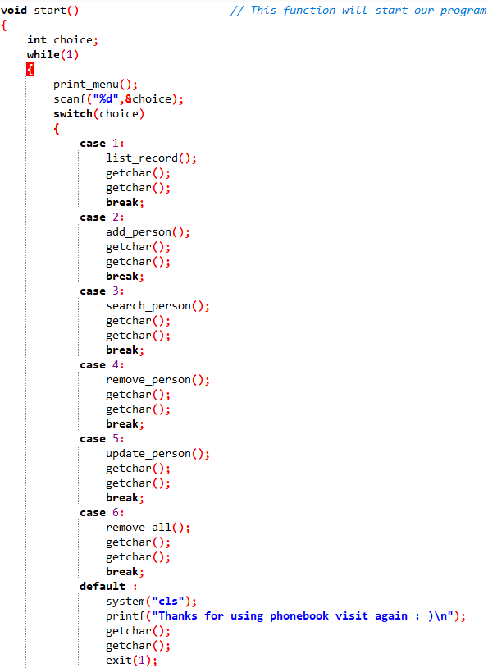
Start function

Slide 11
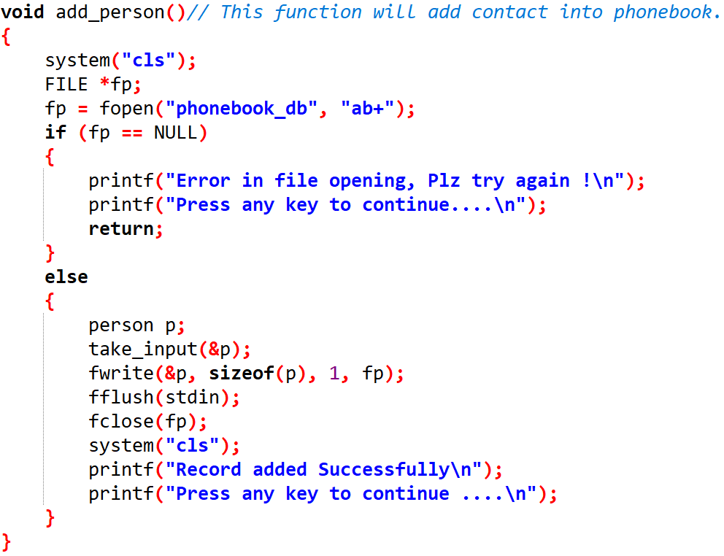
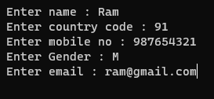
Adding contacts

Slide 12
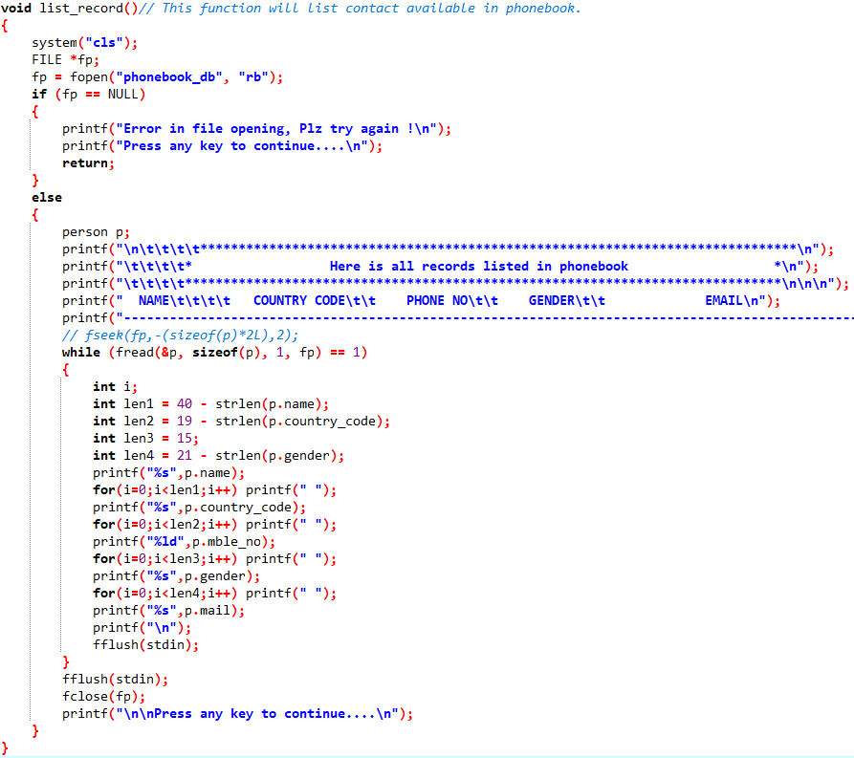

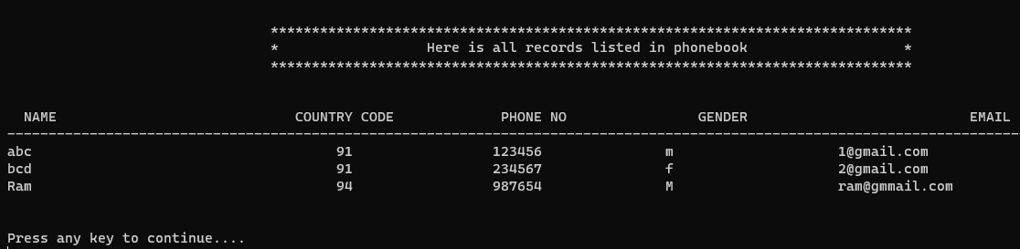
List record

Slide 13
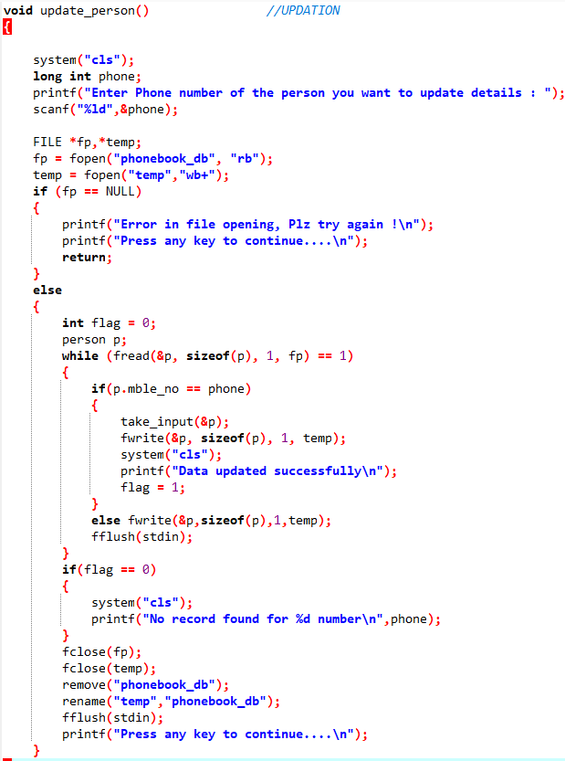
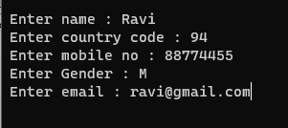

Update contact

Slide 14
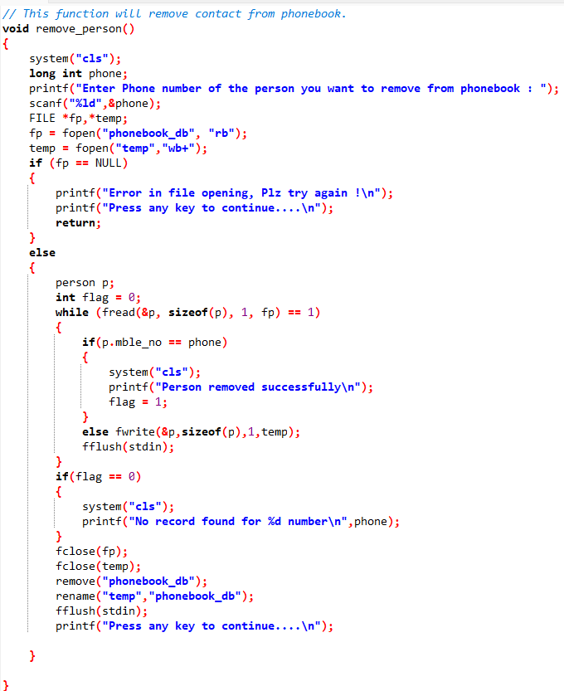

Remove contact

Slide 15
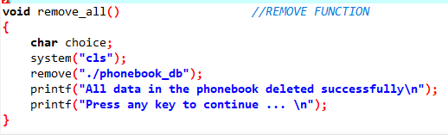
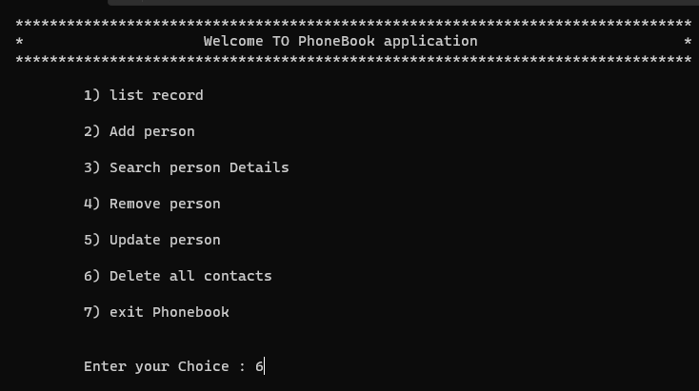
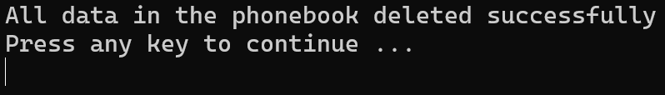
Remove all contacts

Slide 16
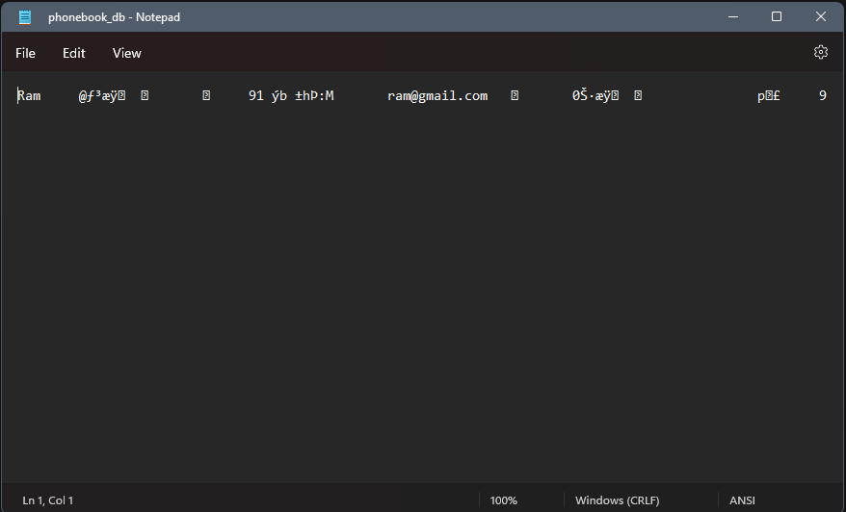
files

Slide 17
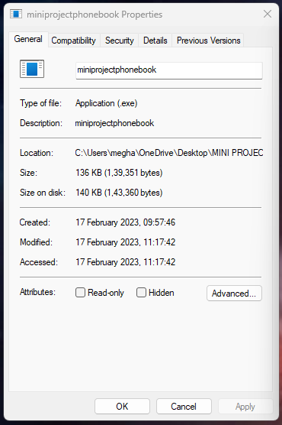
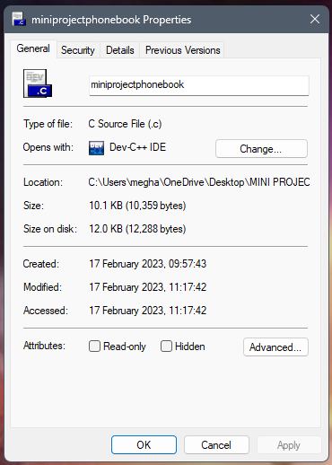
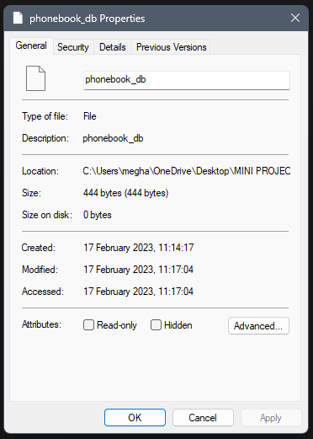
Size of program

Slide 18
Thank you...
-B.M.Sudhamsh.
22BD1A1210

